Slide 1

MedNet
CRACKING THE MEDICAL CODE

Slide 2


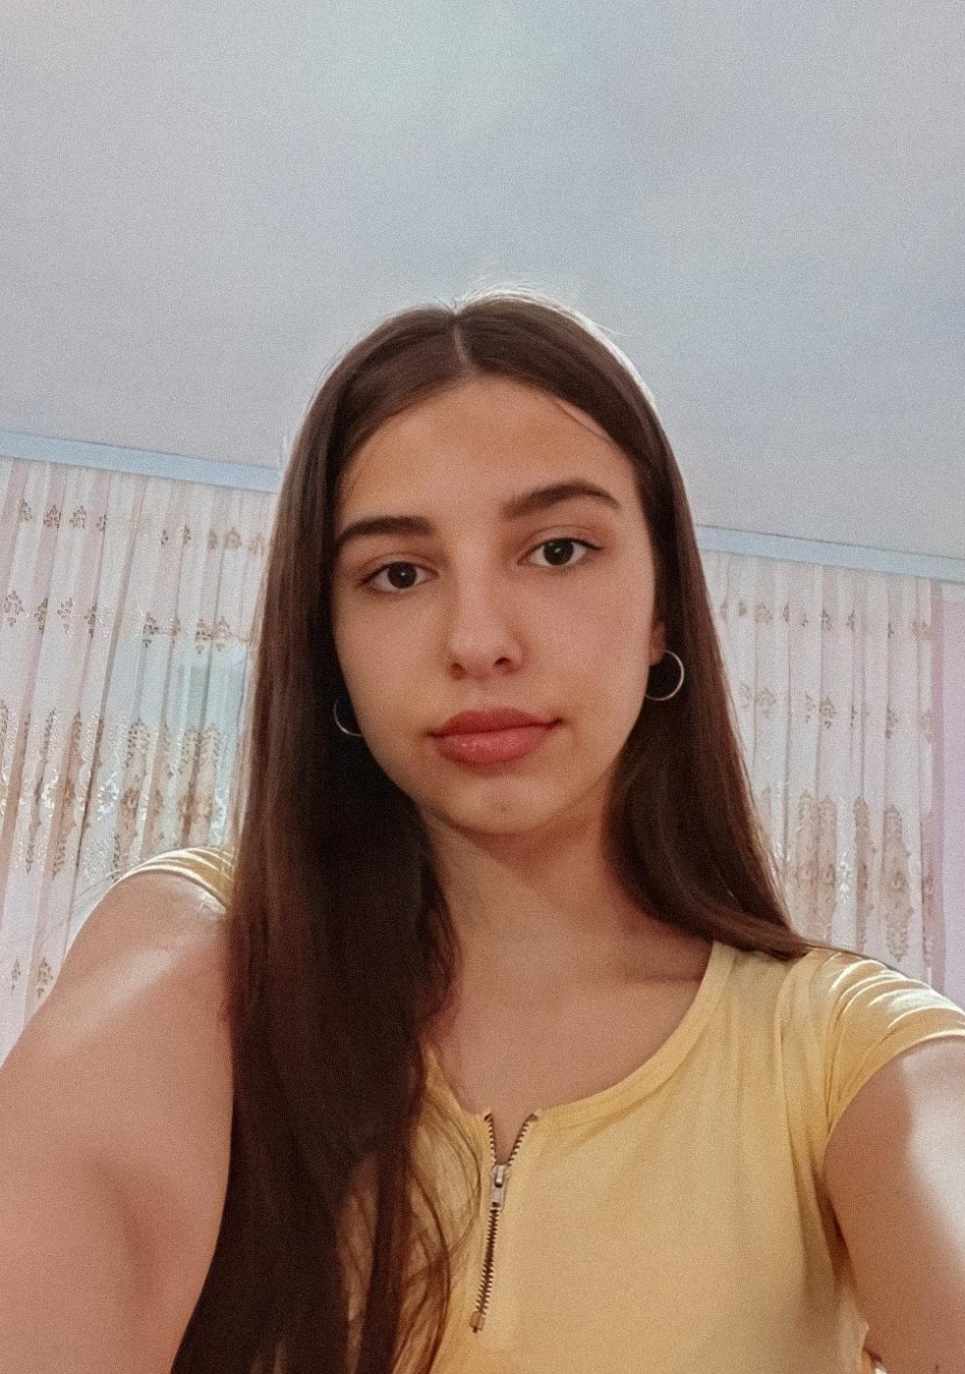


OUR TEAM
Caleb Tiam-Lee
Vilim Borosa
Diona Plakolli
Melinda Eriksson
Erblin Avdija
Leading
Researching
Designing & Marketing
Marketing
Researching

Slide 3

Important information
Mercury’s name has nothing to do with the liquid metal since it was named after the Roman messenger god, Mercury

Slide 4
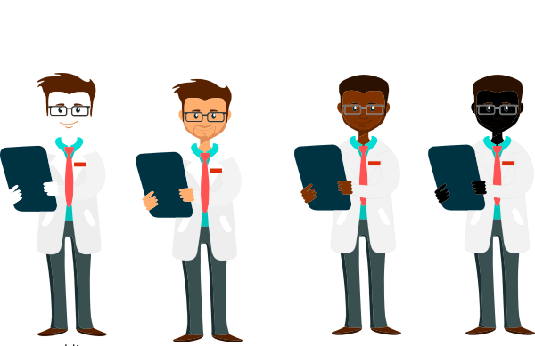

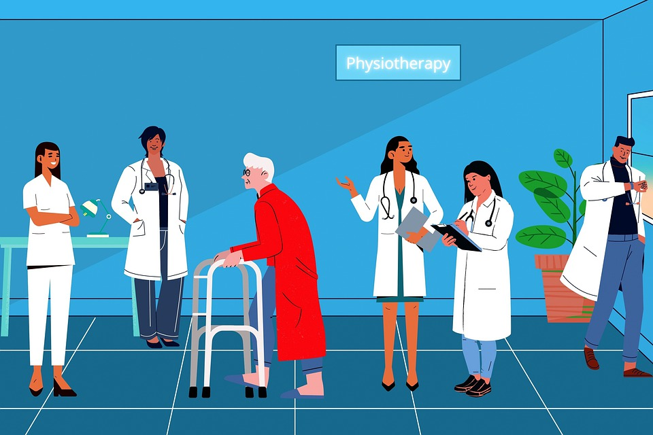
HARD ACCESS TO TECHNOLOGY & INFORMATION
CONNECTION BETWEEN DOCTORS AND PATIENTS IS DIFFICULT
RESEARCH IS SLOW

Slide 5



Blockchain Technology
Main Target
Patients
Doctors
Medical Researchers

Slide 6
The Platform
Project search and development area
Landing Page
Create and join innovation projects
Chat rooms with patients
Sign-Up / Log-In
You can sign-up as a doctor, researcher or legal entity in healthcare, or as a patient
While patients get real-time free instant advice, researchers receive a valuable insight into what patients need

Slide 7



Slide 8
FIRST STEPS TIMELINE
AUG 2021
OCT 2021
DEC 2021
25-50 researchers
50 – 100 patients
100+ researchers
First innovation products on the market
200+ researchers
50+ projects
3000+ patients
Platform
Published
(development and marketing timeframe: cca 30 days)
SEP 2021
NOV 2021
50 - 100 researchers
10k in share revenue achieved

Slide 9
REVENUE STREAMS
ADVERTISEMENTS
PROMOTION OF PRODUCTS
PARTIAL PROFIT FROM PROJECTS

Slide 10
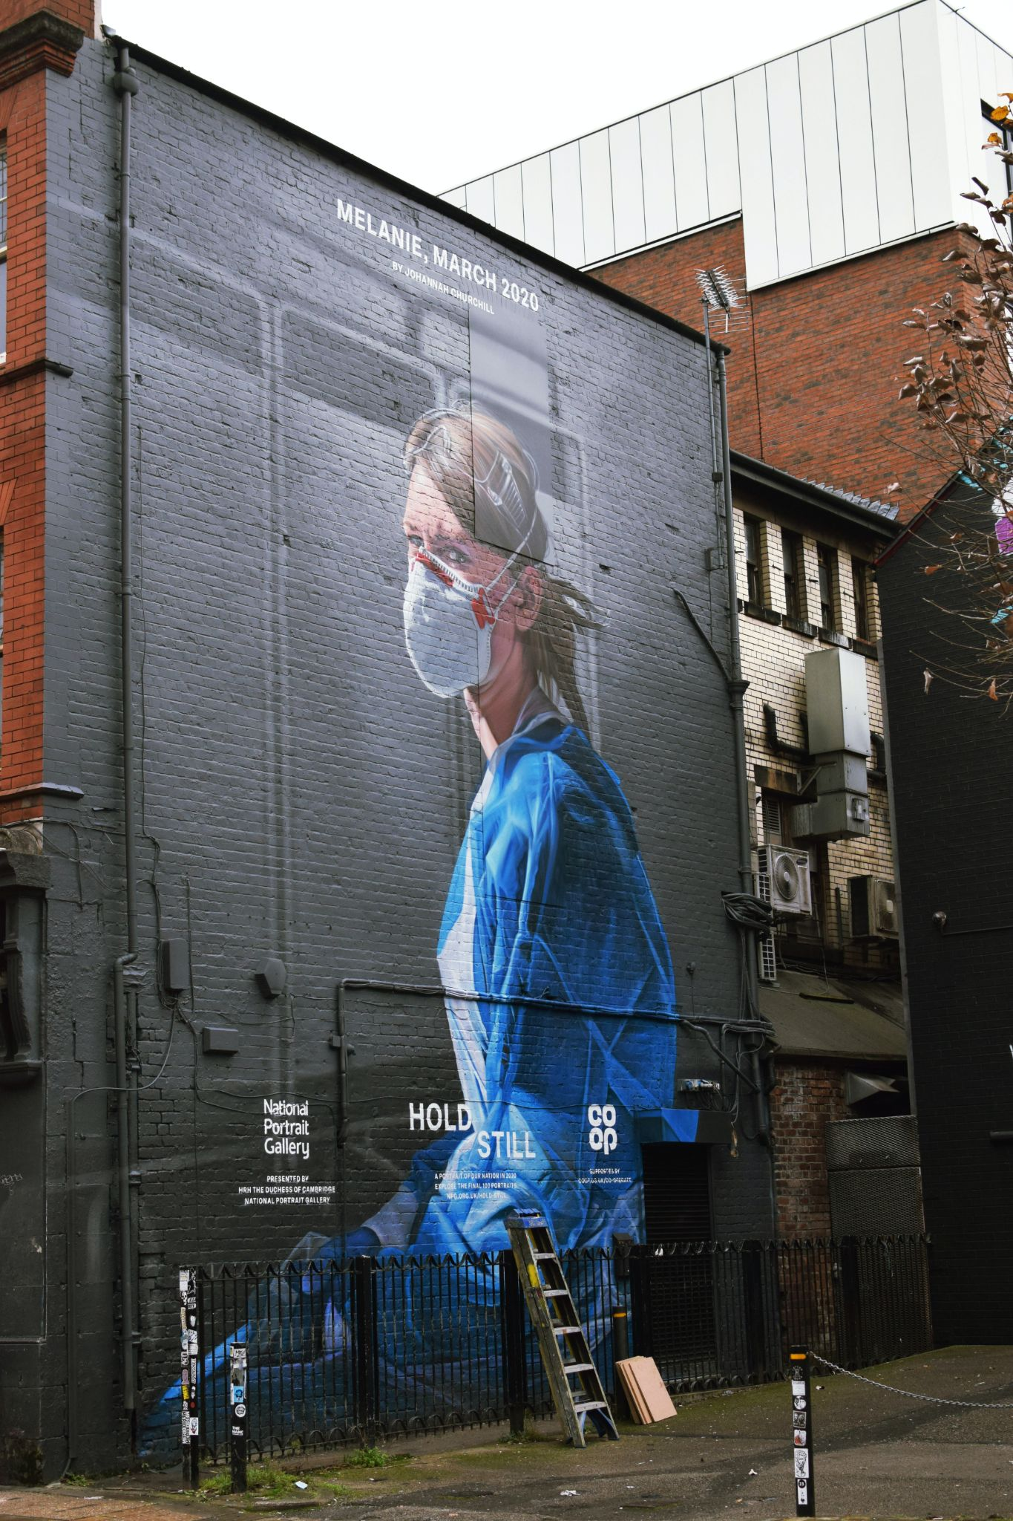
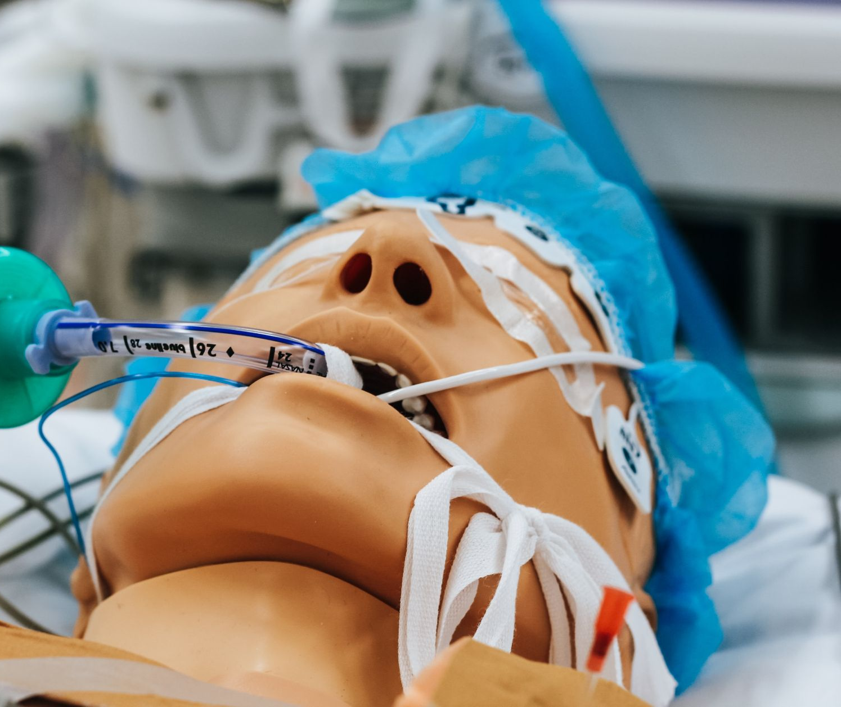
Feasibility of Business
Business Growth
Help Patients
1
2
3
4
Scientific Growth
Easy-To-Use

Slide 11



Let’s Crack The Medical Code Together!
Thank you!
Contact Us:
@mednetweb
team.mednet2021@gmail.com

